Slide 1
American literature IV
VY_32_INOVACE_15-15
After WWII

Slide 2
American society after WWII
America focused more on serious problems than before
mood: nervousness, aggressivity, loss of ideals
people have to deal with the problems of highly developed indrustrial society which led to dozens movements → civil rights, women`s rights
authors wrote about many topics and themes

Slide 3
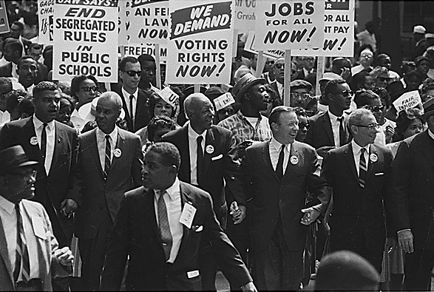
Civil Rights Movement
Autor: neznámý
Název: 1963 march on washington.jpg
Zdroj: http://en.wikipedia.org/wiki/File:1963_march_on_washington.jpg

Slide 4
Topics for writers
brutality of war (Mailer, Styron, Heller)
protests against society (Kerouac, Ginsberg, Bukowski)
selfidentification, place in society (Salinger, Updike, Miller)

Slide 5
Brutality of war
NORMAN MAILER (1923 – 2007)
“The Naked and the Dead”
a group of soldiers survives an attack on an island occupied by the Japanese
JOSEPH HELLER (1923 – 1999)
“Catch 22”
antiwar novel with black humour / compared to Hašek - lots of characters
captain Yossarian – wants to desert from the army – life more important than nationalism
“ Hlava XXII” = military rules – idiomatic usage: non-win situations – absurdity of bureaucracy, satire, slang, vulgar lang., black humor

Slide 6
WILLIAM STYRON
1925 – 2006
Sophie`s Choice
reflexes the horrors of fascism and concentration camps
a Polish woman Sophie Zawistowska, who lost her children in Auschwitz, depicts the Nazis` crimes against humanity, Holocaust
choice between 2 children Jan and Eva
Nathan Landau – Sophie`s lover, schizofrenic
made into a film starring Meryl Streep

Slide 7
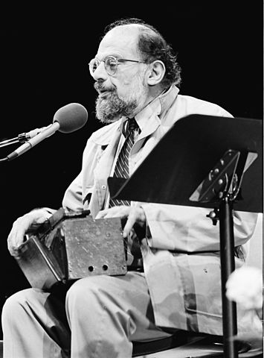
Allen Ginsberg
Autor: MDCarchives
Název: Allenginsberg.jpg
Zdroj: http://en.wikipedia.org/wiki/File:Allenginsberg.jpg

Slide 8
Protests against society
Beat Generation
= movements of 1950`s – involve drugs, alcohol, strange sense of humour, reflect relationships based on disillusionment and disagreements
JACK KEROUAC (1922 – 1969)
“On the Road”
autobiography
CHARLES BUKOWSKI
poetry, prose
ALLEN GINSBERG (1926 – 1997)
a poet
“Howl”

Slide 9
Selfidentification, place in society
JEROME DAVID SALINGER (1919 – 2010)
“The Catcher in the Rye”
JOHN UPDIKE (1932 – 2009)
“Rabbit Run”
a writer of short stories, a critic
ARTHUR MILLER (1915 – 2005)
a playwright, essayist, M. Monroe`s husband
“Death of Salesman” – tragedy about an ordinary man who failes both at work and in his personal life

Slide 10
Black Americans, minorities as heroes…
TENNESSEE WILLIAMS (1911 – 1983)
a playwright
“A Streetcar Named Desire”
“A Cat on a Hot Tin Roof”
TRUMAN CAPOTE (1924 – 1984)
“Breakfast at Tiffany`s”

Slide 11
Science fiction
scifi, detective stories, spy and other stories/novels/plays
RAY BRADBURY (1920 – 2012)
“Fahrenheit 451”
WOODY ALLEN (1935)
playwright, director, actor, musician
“Annie Hall”, “Manhattan”, …
K. KESEY (1935 – 2001)
A link between Beat gener. and hippies
“One Flew Over The Cuckoo`s Nest”

Slide 12
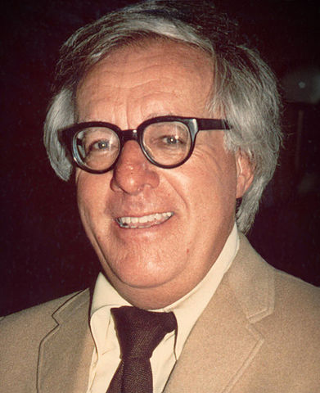
Ray Bradbury
Autor: Alan Light
Název: Ray Bradbury (1975) -cropped-.jpg
Zdroj: http://cs.wikipedia.org/wiki/Soubor:Ray_Bradbury_%281975%29_-cropped-.jpg

Slide 13
Thank you for your attention.
Autor DUM: Mgr. Darina Sikorová

