Slide 1
American literature II
VY_32_INOVACE_15-13
From the Civil War to WWI
American poetry

Slide 2
After the Civil War
development of both society and culture
the West = inspiration: vitality, realism, humour
from romanticism to realism
topics:
  nature
  life after war, hope in rich and better life
  slavery

Slide 3
JACK LONDON
1876 – 1916 (John Griffith Chaney)
- sailor, worker, miner – gold rush to Klondike
- heroes: strong, courageous, democratic vs. ruthless, Alaska
The Call of the Wild – the dog Buck from California to Alaska, his master killed by the Indians, dog survives, escapes from civilization, leads the pack of wolves
The White Fang

Slide 4
MARK TWAIN
1835 – 1910
Samuel Lenghorn Clemens
began as a journalistic humourist, after father`s death apprenticed to a printer
wanted to go to South Am. but stayed as a steam pilot on the Missisippi River, miner in Nevada, travelling
influenced by the life in the Frontier
lost his wife and two daughters – bitter

Slide 5
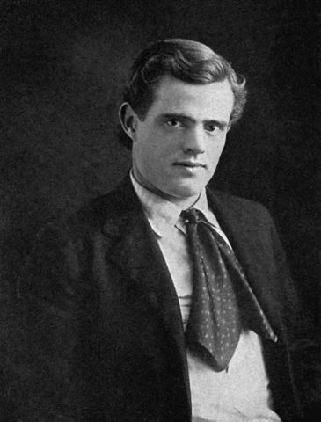
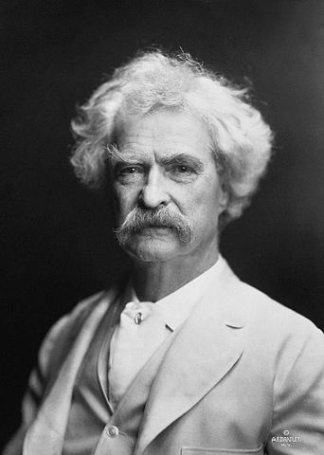
Jack London
Mark Twain
Autor: L C Page and Company Boston 1903
Název: Jack London young.jpg
Zdroj: http://en.wikipedia.org/wiki/File:Jack_London_young.jpg
Autor: A. F. Bradley, Název: Mark Twain by AF Bradley.jpg
Zdroj:
http://cs.wikipedia.org/wiki/Soubor:Mark_Twain_by_AF_Bradley.jpg
Notes:
A.F. Bradley

Slide 6
Books by Mark Twain
The Celebrated Jumping Frog
  fame, local dialect, exaggeration, based on stories from mines in California
Life on the Mississippi
The Adventures of Tom Sawyer
The Adventures of Huckleberry Finn
  set in CW, slavery, serious Amer. problems, hipocricy of religious people, good – bad boys → against the stupidity of the adult world
  Tom: eastern – European, educated, has family, more romantic
  Finn: western, uneducated, natural, practical, rebel X reading banned

Slide 7
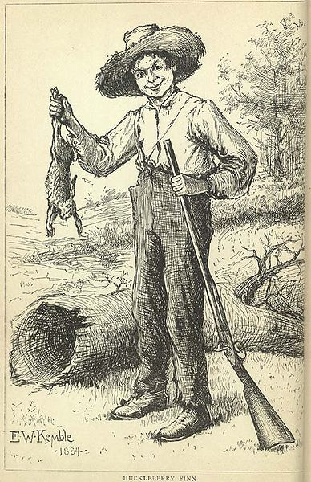
Huckleberry Finn
Název: Huckleberry-finn-with-rabbit.jpg
Autor: Edward Winsor Kemble
Zdroj: http://en.wikipedhttp://cs.wikipedia.org/wiki/Soubor:Huckleberry-finn-with-rabbit.jpg

Slide 8
HERRIET BEACHER STOWE
1811 -1896
antislavery novel, negro slaves and white masters
Uncle Tom`s Cabin
  criticism of American slavery
  first Amer. bestseller

Slide 9
Poetry of the 19th century
some successful poets in these times now considered as minor poets…and vice versa
The New England Brahmins – academic writing, formal poetry, intellectual, too sophisticated, Eur. pattern
the most significant today:
  Walt Whitman
  Emily Elizabeth Dickinson

Slide 10
WALT WHITMAN
1819 – 1892
central figure of moderm Amer. poetry
misunderstood
taboo images: sex; exotic, vulgar language
democratic, equality of people, progress of life, life`s triumph over the death, against slavery, free verse (S.K.Neumann)
Leaves of Grass
  symbol of freedom
  Song of Myself – individuality, novelty, the USA, Cosmos…

Slide 11
EMILY DICKINSON
1830 – 1886
a shy young woman of a highly individual talent, lived in Mass.(Amherst)
7 of 1800 poems published anonymously, 1955 a complete edition published
intense inner life
themes: deaths, faith, funeral, immortality, love, nature – capital letters, dashes, personification, concrete vs. abstract worlds
symbolic, religious, personal, short, lyrical poems
This Is My Letter To The World

Slide 12
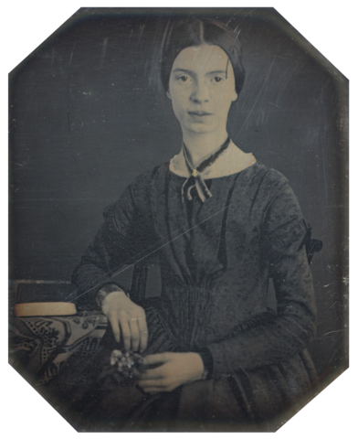
e.m.i.l.y d.i.c.k.i.n.s.o.n
Název: Black-white photograph of Emily Dickinson2.png
Autor: neznámý
Zdroj: http://cs.wikipedia.org/wiki/Soubor:Black-white_photograph_of_Emily_Dickinson2.png

Slide 13
Thank you for your attention.
Autor DUM: Mgr. Darina Sikorová

